Slide 1
Modeling Passive Daytime Radiative Cooling Devices (PDRCs) using COMSOL Multiphysics™
Student: Collins Munene Kariuki
Advisor: Professor Janice Hudgings

Slide 2
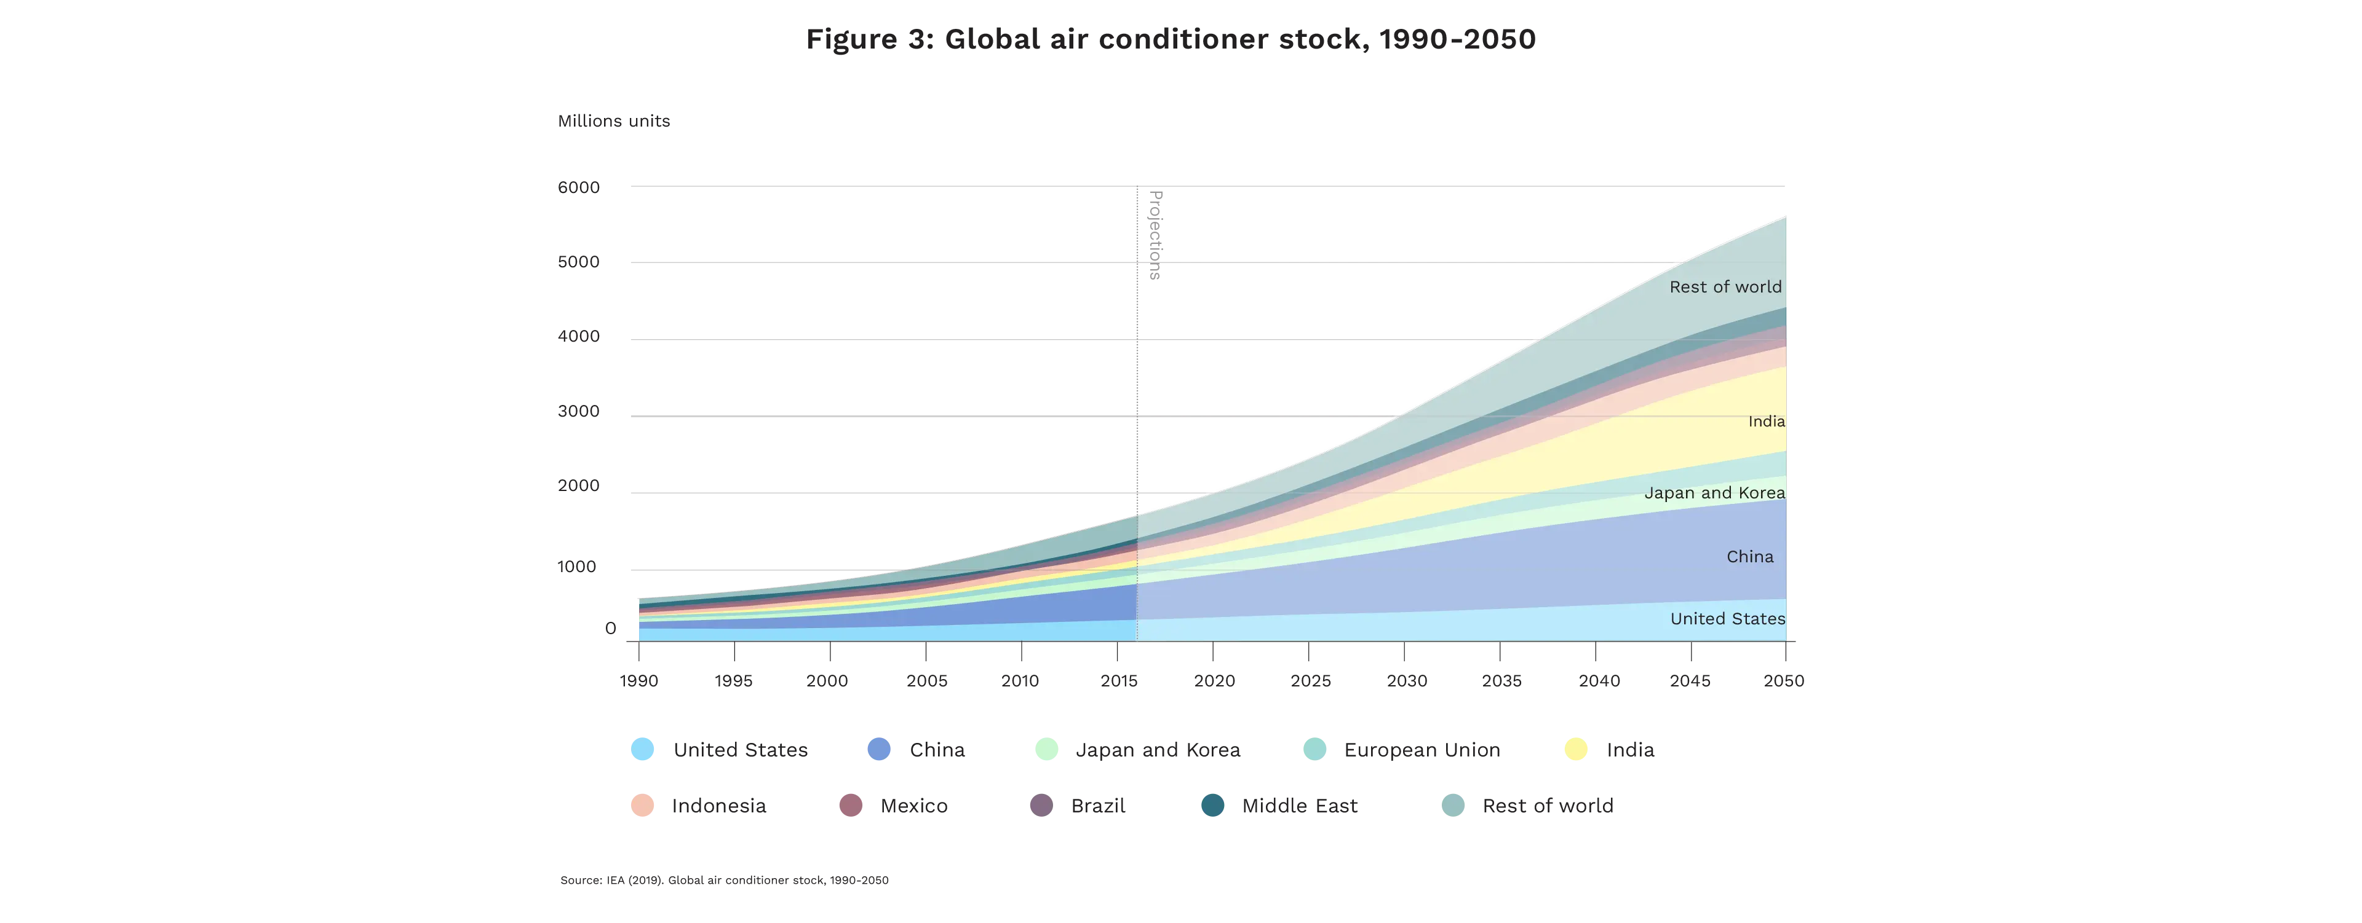
Motivation.
Global warming
More emissions and heat dumped outside
More AC use
The heat island effect describes how urban areas are significantly warmer than their rural counterparts, largely because of human activities.
By 2050, around 2/3 of the world’s households could have an AC. China, India and Indonesia will together account for half of the total number.

Slide 3
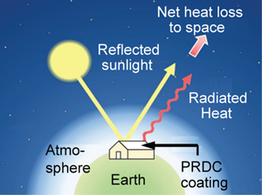
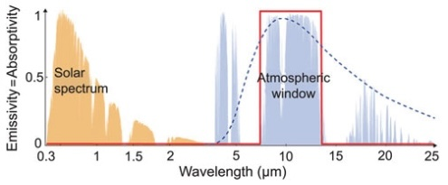
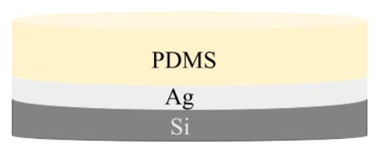
So, What are PDRCs?
Radiative passive cooling occurs when objects emit more radiation than the combined radiation they absorb. Thus, radiative passive cooling is an electricity-free method for cooling terrestrial entities
Passive Daytime Radiative Cooling: Principle, Application, and Economic Analysis (Yang & Zhang, 2020)
Passive Daytime Radiative Cooling: Principle, Application, and Economic Analysis (Yang & Zhang, 2020)
0% absorptivity (100% reflectance) in the solar spectrum (0.3–2.5 μm), so the surface is not heated by sunlight in daytime at all.
Emittance of 1 in the λ = 8–13 μm window of the atmosphere, where it is partially transparent, since there is limited infrared absorption by gas molecules.
Modeling and Testing Passive Daytime Radiative Cooling Devices (DiBari, 2023)

Slide 4
Thesis Goals.
Use COMSOL to model PDRCs but COMSOL is… hard
Plotting the reflectance (R) vs wavelength for the basic Si + Ag + PDMS structure.
Understanding how to use COMSOL Multiphysics
To do this I verify simulations on (anti)-reflectivity by benchmarking them against established optics literature.
- Modeling anti-reflectance coatings.
- Modeling (multi-layer) high reflectance coatings.

Slide 5
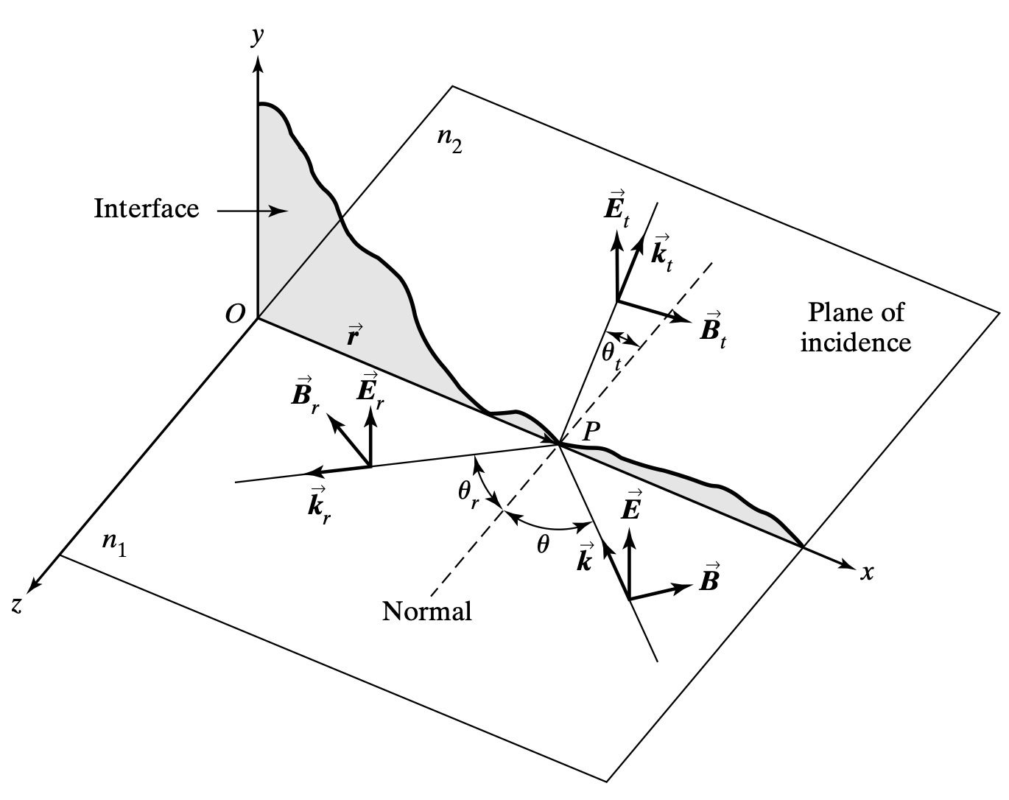
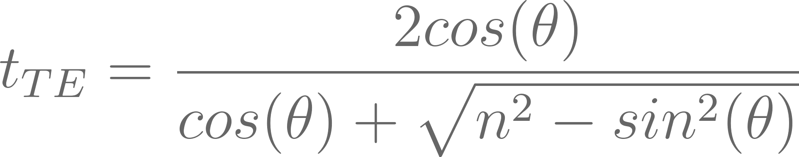
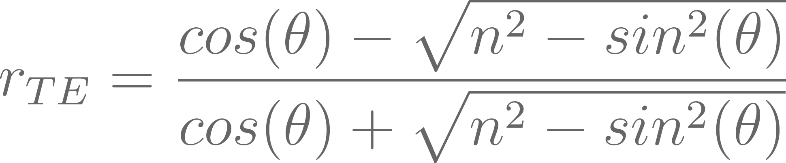
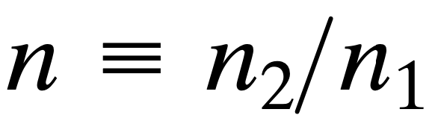
Theory (Single Interfaces & Fresnel Equations)
F. L. Pedrotti, L. M. Pedrotti, and L. S. Pedrotti, Introduction to optics, 3rd ed. 2007.
The Fresnel equations describe how light behaves when it encounters the boundary between two different media, such as glass and air.
They determine the proportion of light that is reflected or transmitted at the interface, based on the incident angle and the polarization of the light.

Slide 6
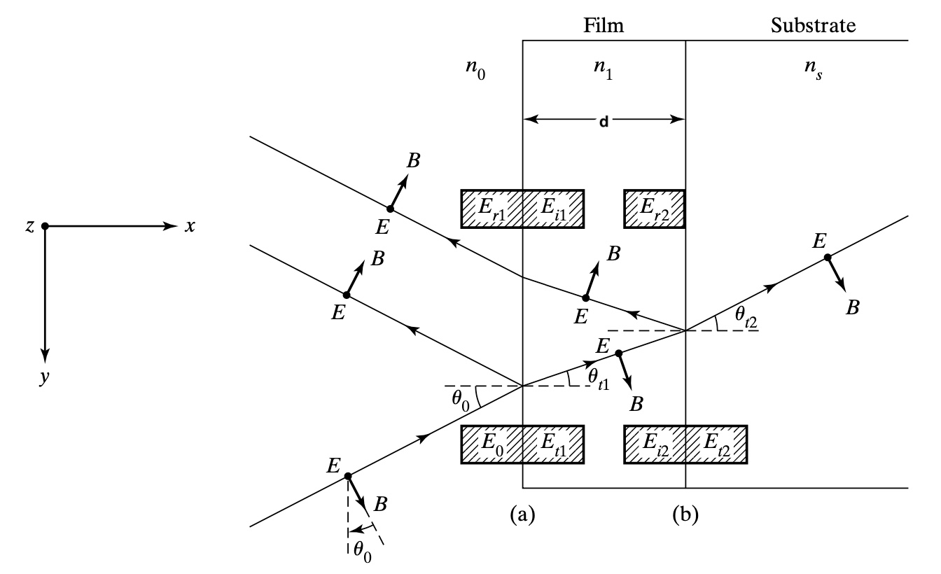
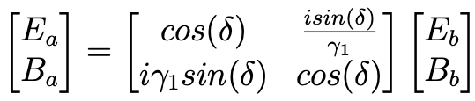
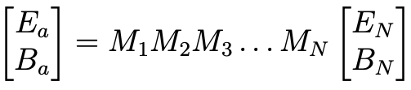
Theory (Multiple Interfaces & the Transfer Matrix)
When light encounters multiple interfaces the complexity of reflection and transmission calculations increases significantly.
The transfer matrix approach allows for the systematic calculation of light behavior through multiple layers with varying refractive indices and thicknesses.
n is a function of the wavelength (λ) of light… we need COMSOL!!
F. L. Pedrotti, L. M. Pedrotti, and L. S. Pedrotti, Introduction to optics, 3rd ed. 2007.

Slide 7
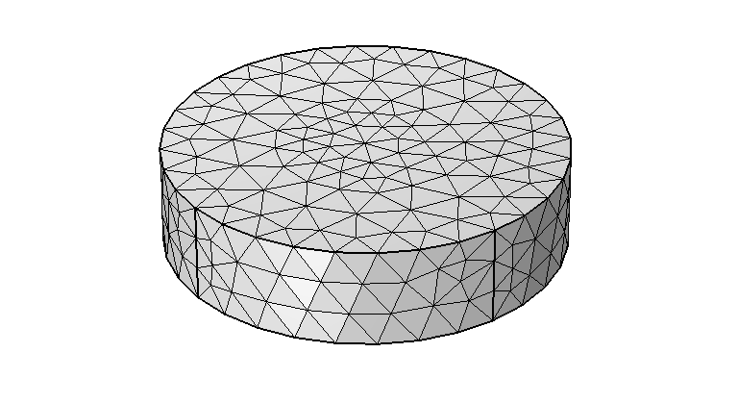
COMSOL Multiphysics ™
Initialization of the modelling environment
Geometry construction
Material property specification
Physics boundary conditions
Mesh generation
Simulation execution
Results post-processing
Normal-sized mesh

Slide 8
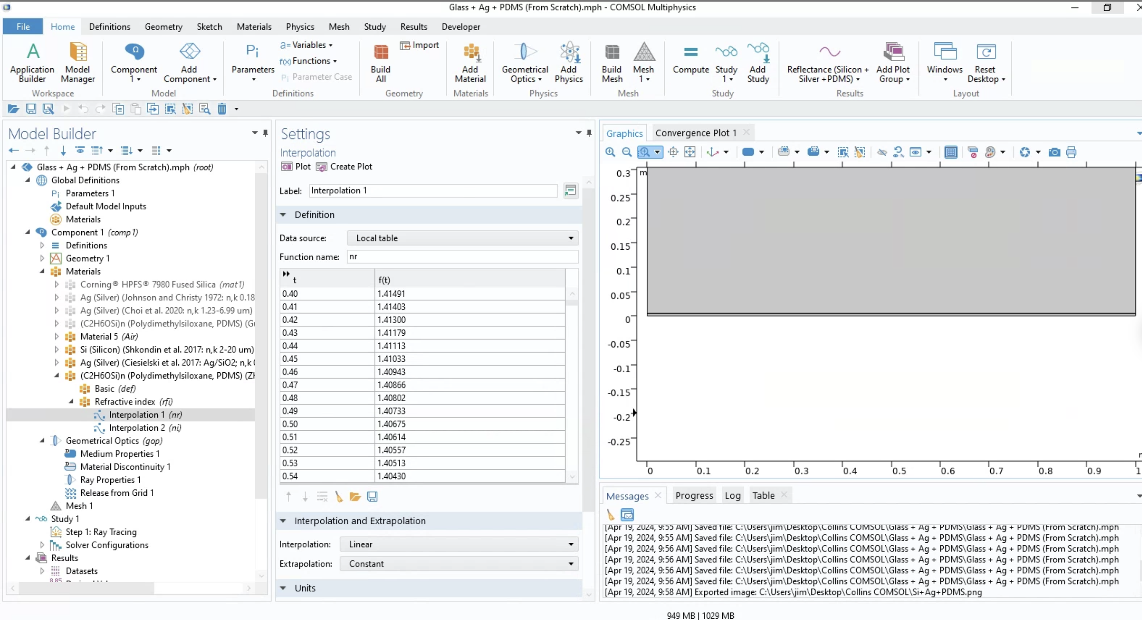

Slide 9
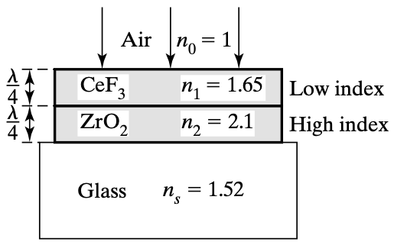
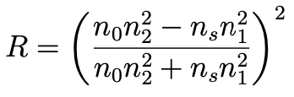
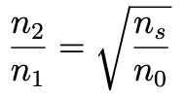
Validation of Models Against Established Literature
Anti-reflectance coatings are designed to minimize reflection and maximize transmission of light through strategic manipulation of refractive indices across different layers.
F. L. Pedrotti, L. M. Pedrotti, and L. S. Pedrotti, Introduction to optics, 3rd ed. 2007.

Slide 10
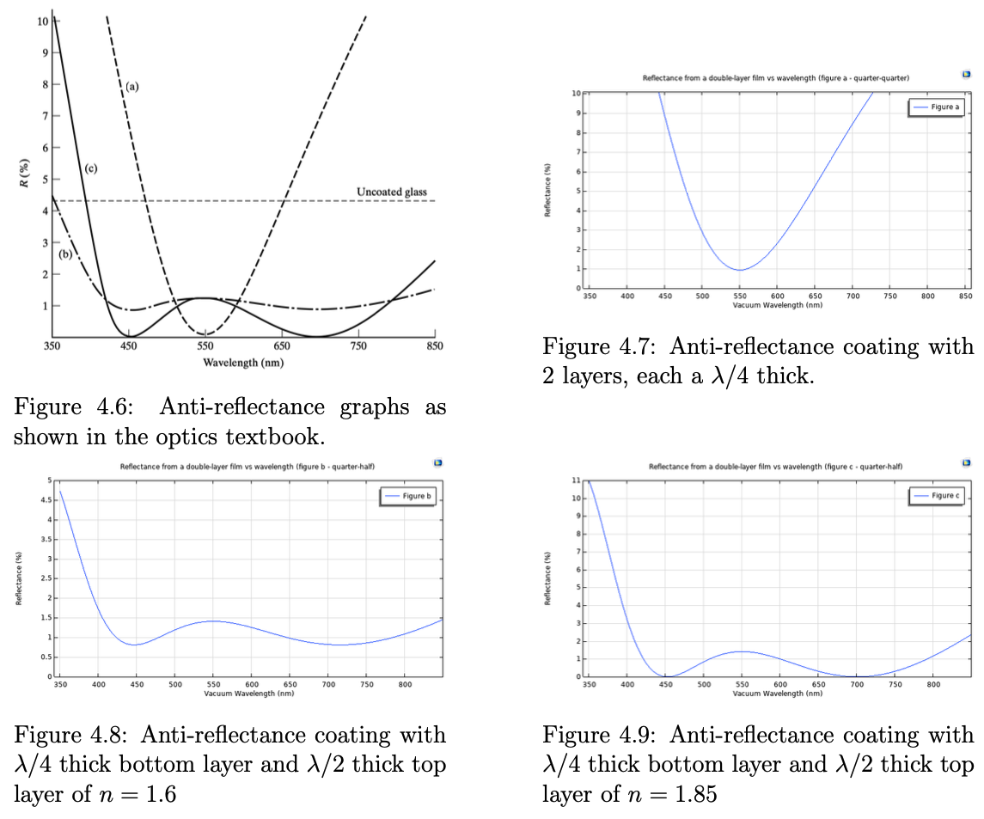
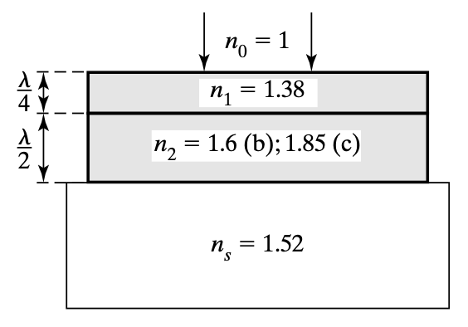
Validation of Models Against Established Literature
COMSOL
THEORY
F. L. Pedrotti, L. M. Pedrotti, and L. S. Pedrotti, Introduction to optics, 3rd ed. 2007.
COMSOL
COMSOL

Slide 11
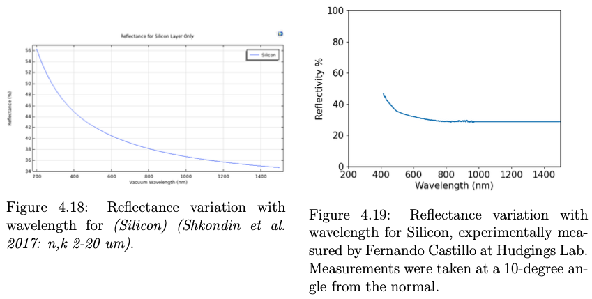
PDRC Device Modeling (Silicon Only)
COMSOL
EXPERIMENT

Slide 12
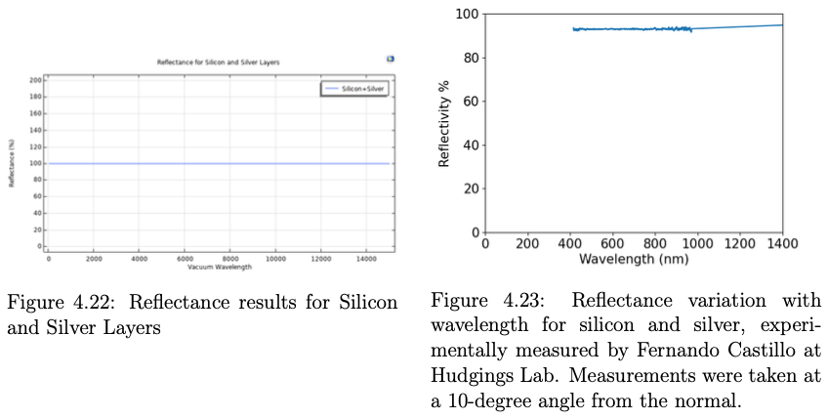
PDRC Device Modeling (Si + Ag)
COMSOL
EXPERIMENT

Slide 13
Conclusions and Future Work
COMSOL is a versatile tool for simulating a wide range of phenomena across various physics disciplines.
It's reassuring to know that we can validate our simulations against established theoretical optics literature.
Successfully modeled anti-reflectance coating, (multi)-layer high-reflectance coatings, Fresnel equations etc.
Enhance the PDRC design by layering additional materials atop the PDMS layer, experimenting with various thicknesses and refractive indices to more efficiently harness constructive interference across multiple interfaces.
The translation of computational models into physical prototypes for empirical validation in lab settings, comparing simulated reflectance with real-world performance.
Development of reflectance versus angle of incidence models to aid in the characterization of PDRC behavior throughout the day.

Slide 14





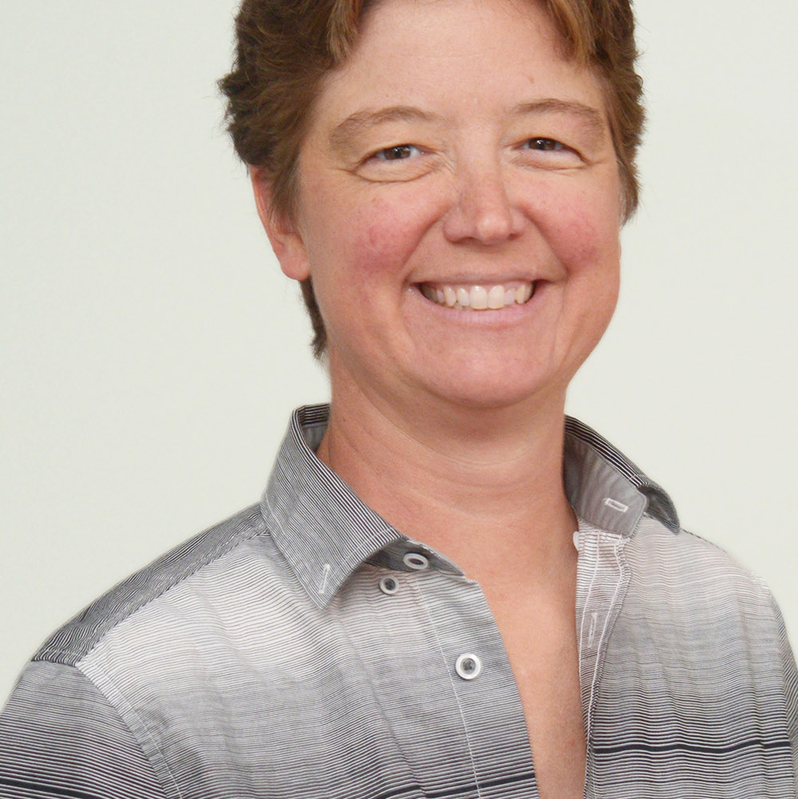

Acknowledgements
ORGANIZATIONS
HUDGINGS LAB
Koh Rombouts Goldman Sachs Scholarship Fund
FACULTY
Prof. Hudgings
Dr. Higdon

Slide 15
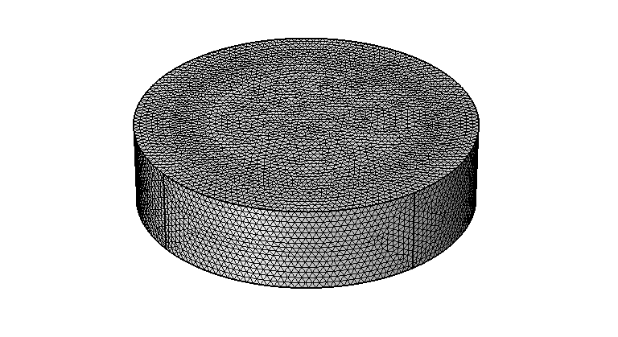
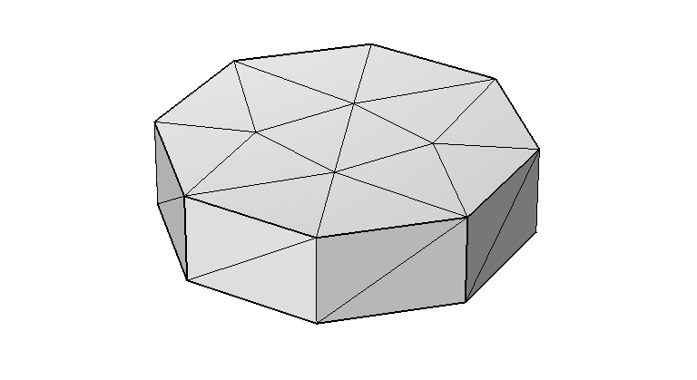
Appendix (the Mesh)
Divides the model’s geometry into smaller, discrete elements, such as prisms in 3D, or triangles in 2D.
Discretization: The mesh breaks down a continuous domain into discrete pieces, allowing for the numerical solution of partial differential equations that describe the physics of the problem.
Extremely fine mesh
Normal-sized mesh
Extremely coarse mesh
The density and quality of the mesh influence the accuracy of the results. A finer mesh can provide more precise solutions but requires more computational power.
Notes:
Yes, that's a correct and succinct way to describe the process. Discretizing the geometry into a mesh breaks the model into smaller, manageable elements where local solutions to the governing equations are computed. The program then intelligently combines these local solutions, considering the boundary and continuity conditions at the interfaces between elements, to construct a solution for the entire domain.
It’s not just simple summation, though. The combination involves complex numerical methods that ensure the physical laws are satisfied throughout the entire domain. This aggregate solution gives insights into the spatial distribution of the physical quantities, such as temperature variations, electromagnetic fields, stress distribution, or fluid flow patterns, across the entire geometry being modeled.

